Slide 1

ISA 630 – Machine Learning for Business Applications
Machine Learning for Business Applications
Overview of the Course

Slide 2
Instructor
Dr. Waldyn Martinez
Office: 2020
Email: martinwg@miamioh.edu
Office Phone: 513.529.2154
Area of Expertise: Dr. Martinez' research is focused on the area of Statistical Machine Learning, specifically in the theory and applications of ensemble, hybrid and deep learning algorithms.

Slide 3
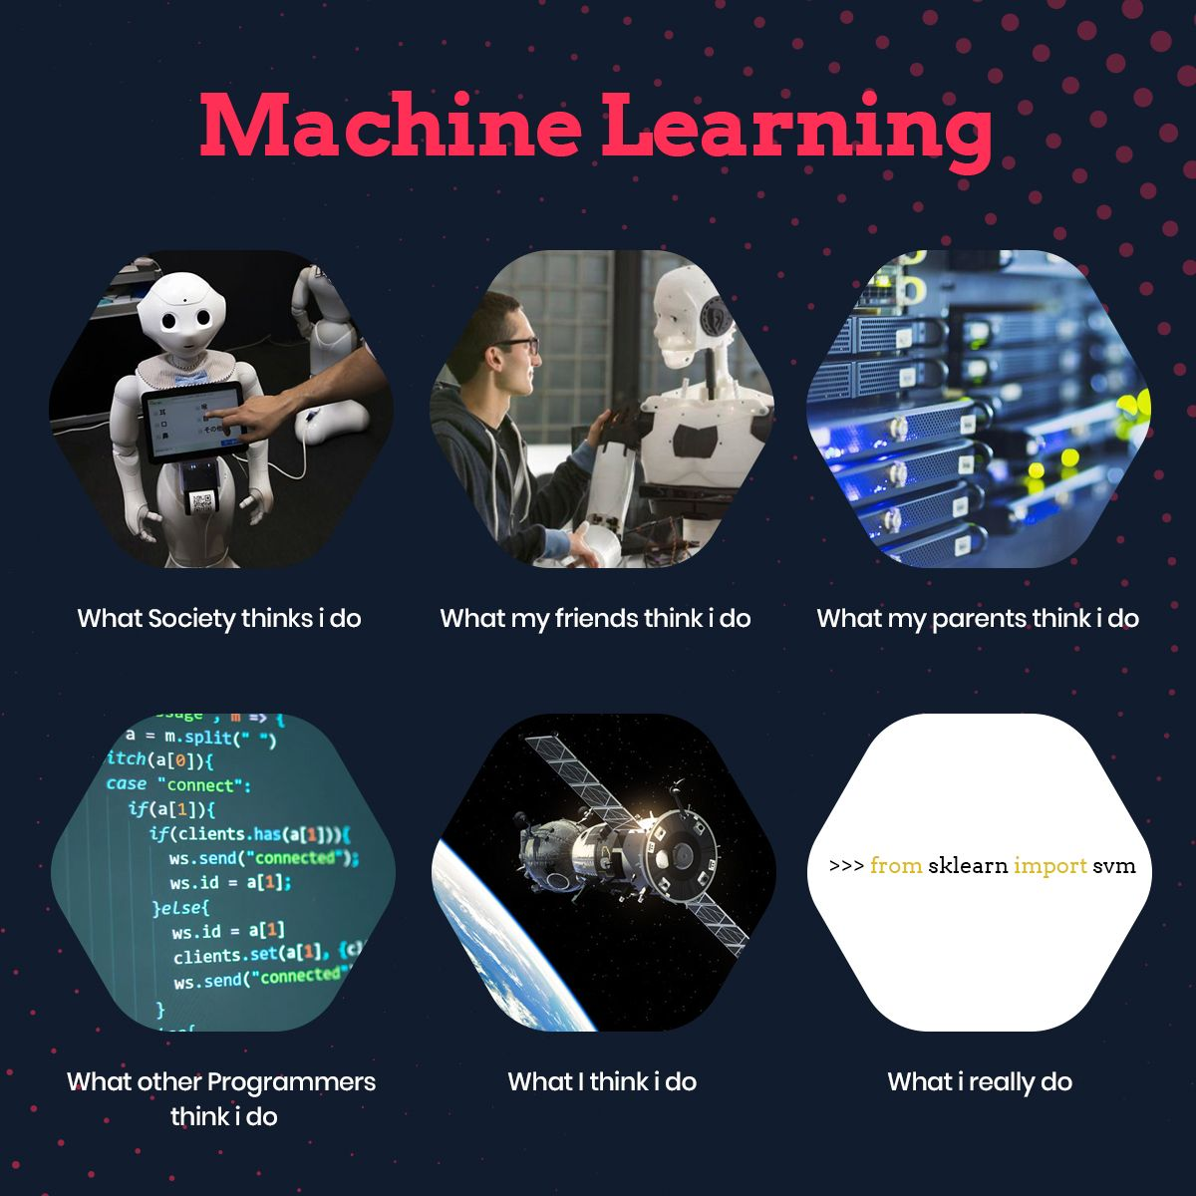
What is Machine Learning?

Slide 4

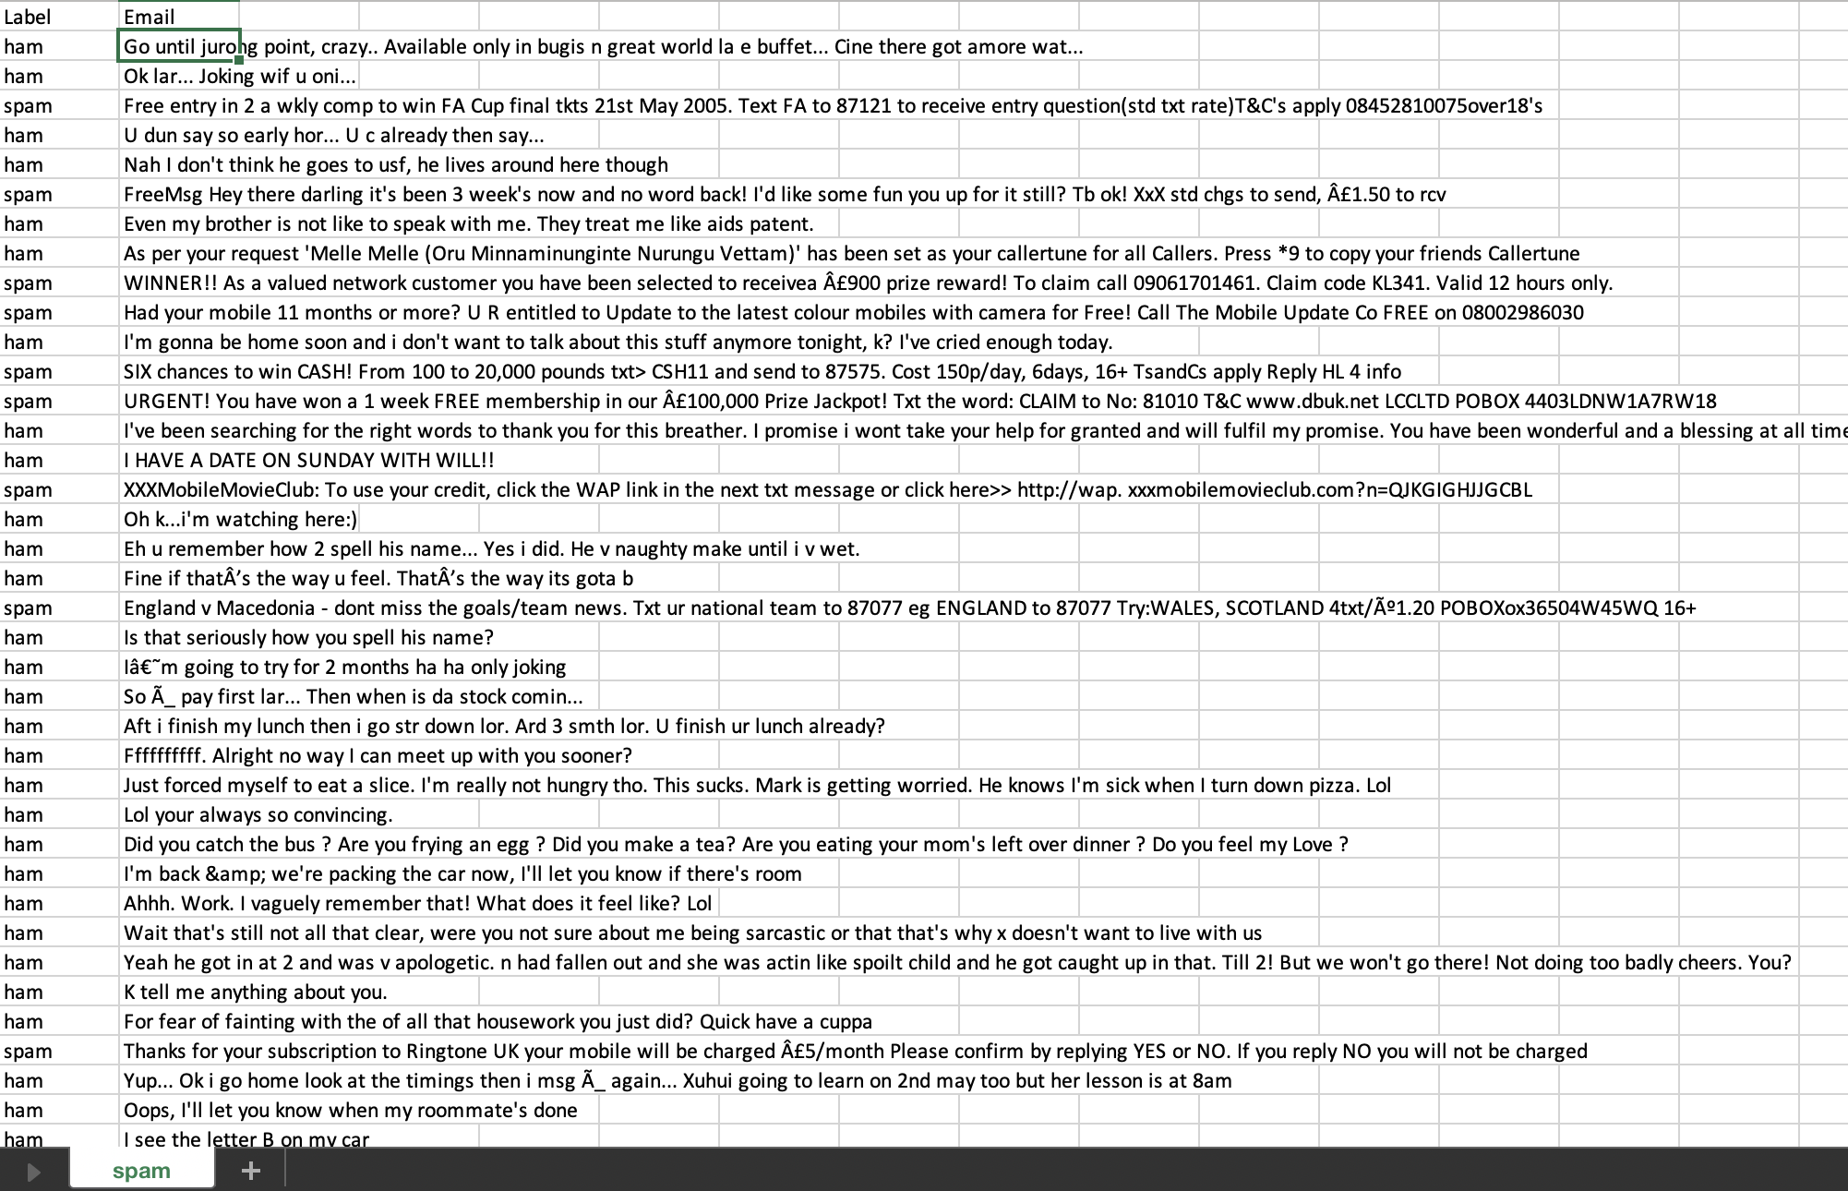


What is Machine Learning?
Machine Learning is the field of study that gives computers the ability to learn without being explicitly programmed (Arthur Samuel, 1959).
A computer program is said to learn from experience E with respect to some task T and some performance measure P, if its performance on T, as measured by P, improves with experience E (Tom Mitchell, 1997).
Experience
Task
Performance measure
Actual
Predicted
Minimize
Minimize

Slide 5
EXAMPLE 1

Slide 6
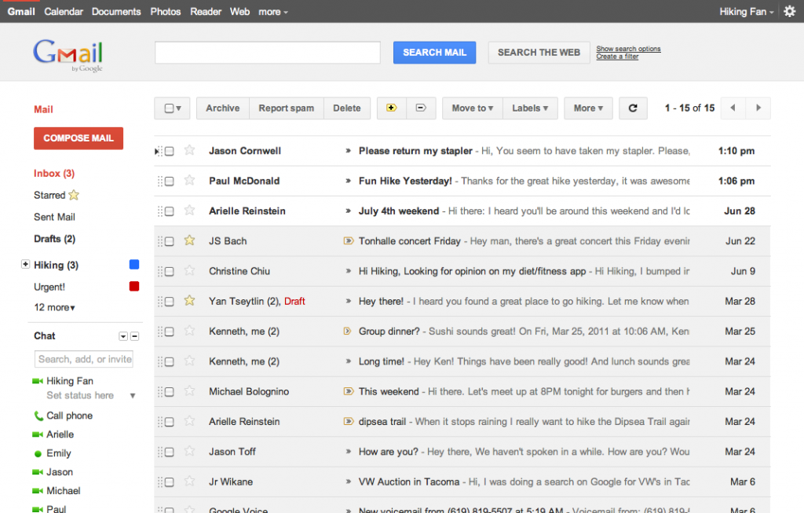
Task (T)
Task: Automatically classify an email as Spam (Bad) or Ham (Good)

Slide 7
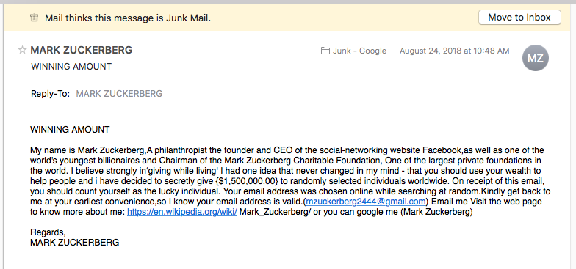
Task (T)
Task: Automatically classify an email as Spam (Bad) or Ham (Good)

Slide 8
Experience (E)
Experience: You are given a dataset with emails labeled Spam (Bad), Ham (Good)

Slide 9
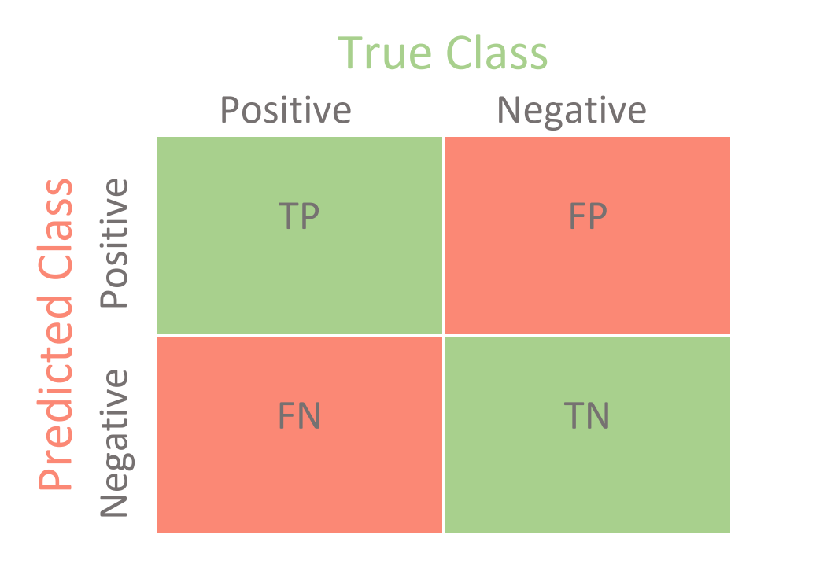
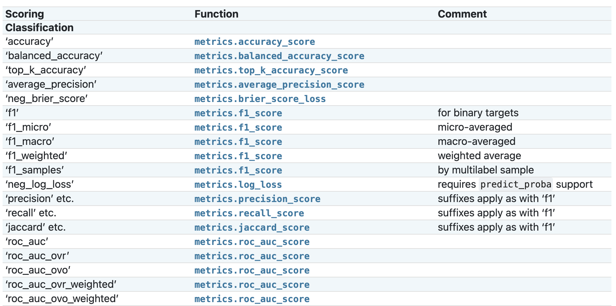
Performance Measure Metrics (P)
Performance Measure: Check how good is your ML algorithm.
Common Classification Metrics
True Positives (TP)
True Negatives (TN)
Confusion Matrix
False Positives (FP)
False Negatives (FN)
Scikit-Learn Classification Metrics

Slide 10
EXAMPLE 2

Slide 11
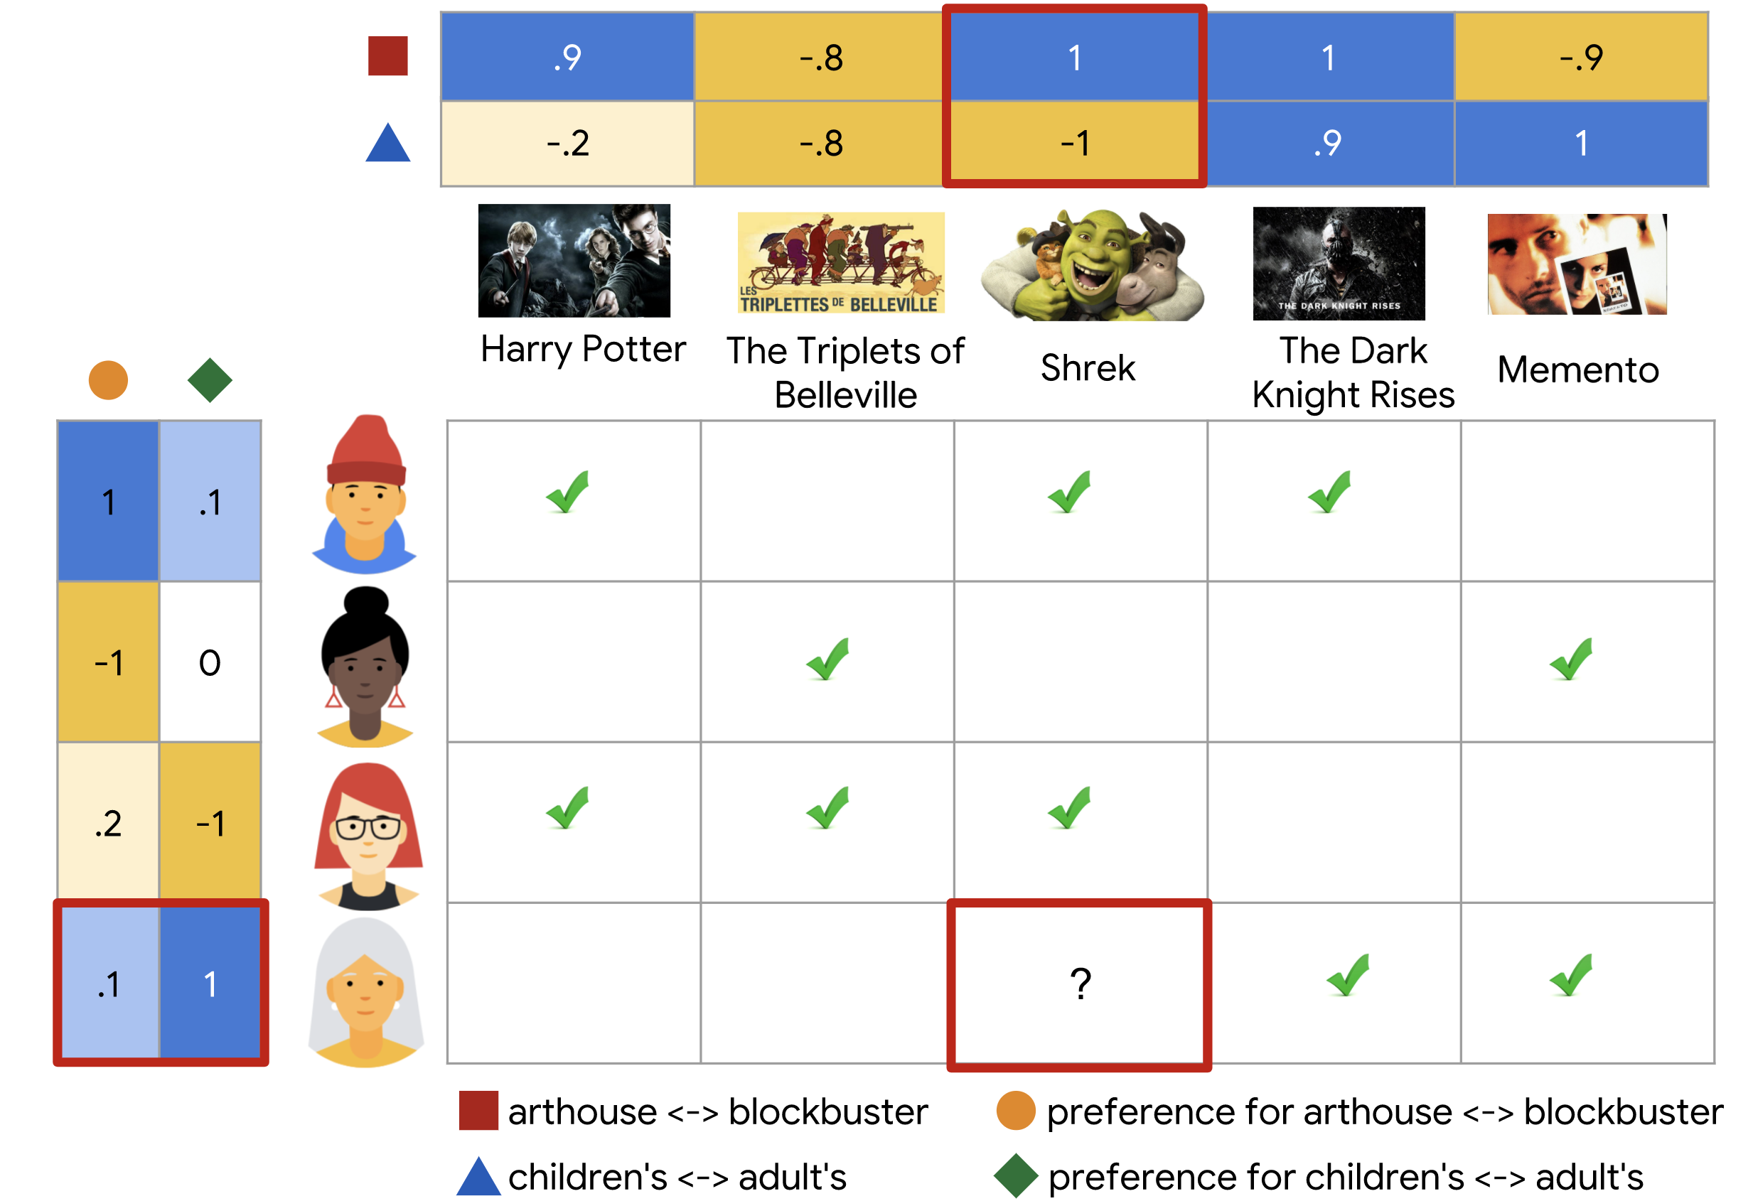

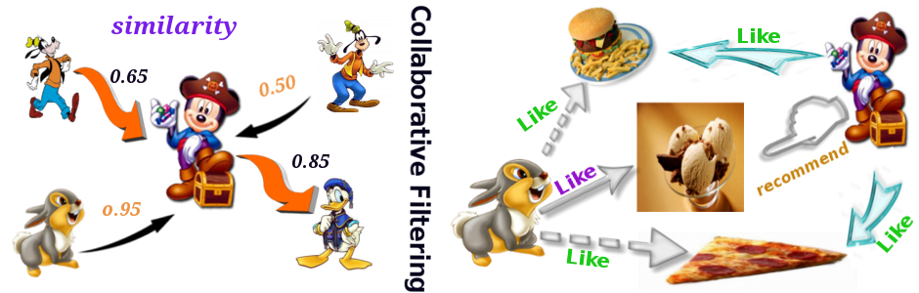
Task (T)
Task: Product recommendation

Slide 12
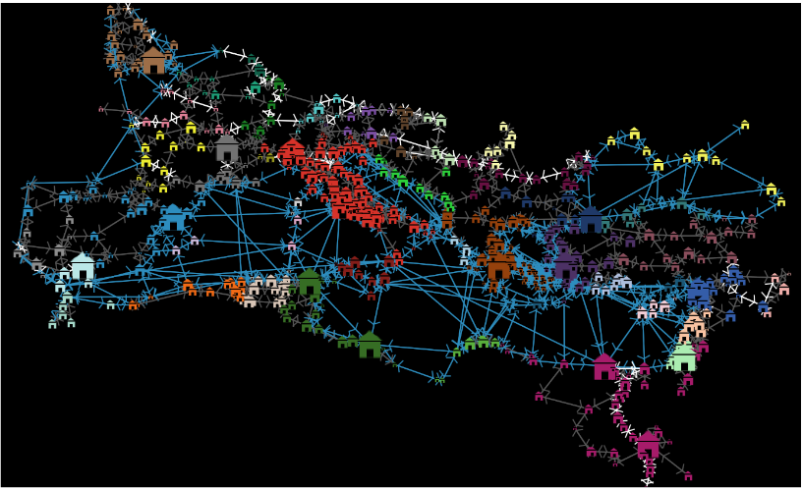

Experience (E)
Experience: Product/Customers Sales Information

Slide 13

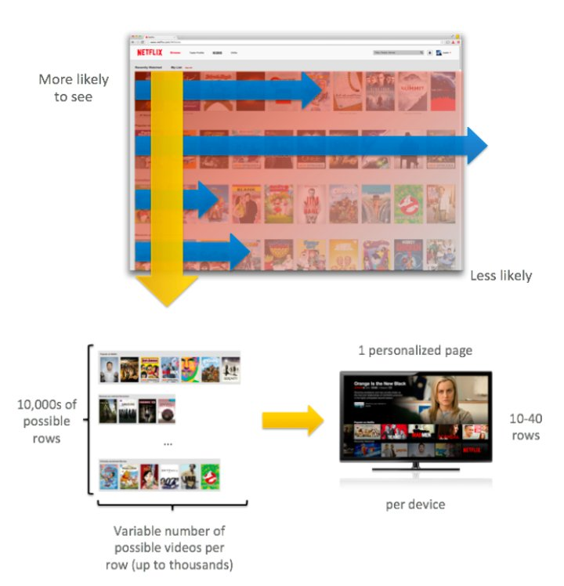
Performance Measure Metrics (P)
Performance Measure: Problem-Specific

Slide 14
EXAMPLE 3

Slide 15
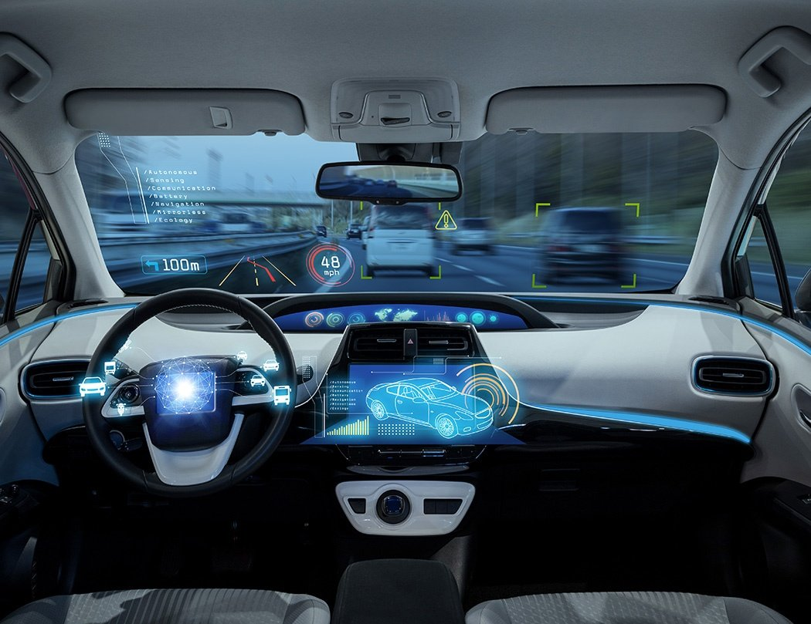
Task (T)
Task: Keep autonomous driving car in lane

Slide 16
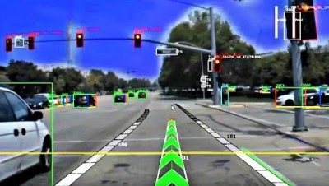
Task (T)
Task: Keep autonomous driving car in lane

Slide 17
Experience (E)
Experience: You are given a dataset with emails labeled Spam (Bad), Ham (Good)

Slide 18
Performance Measure Metrics (P)
Performance Measure: Check how good is your ML algorithm.
Common Classification Metrics
True Positives (TP)
True Negatives (TN)
Confusion Matrix
False Positives (FP)
False Negatives (FN)
Scikit-Learn Classification Metrics

Slide 19

Machine Learning | AI | Deep Learning

Slide 20
Machine Learning Tasks

Slide 21





Course Expectations
Will I be programming?
Hard work?
Math and Statistics?
Research on your own?

Slide 22

Agenda
Introduction to Python for ML:
Access Python through Anaconda Navigator on your computer or Lab computer, Google Colab using any computer.
understand the basics of Jupyter Notebooks.
understand the main core Python programming principles (variable types, loops, conditionals)
understand how to construct basic functions in Python, and how to import modules and packages
understand the basics of lists, tuples and dictionaries.
be able to use basic manipulation of data, and datasets using NumPy and Pandas
be able to create plots using the matplotlib.pyplot module

